Slide 1
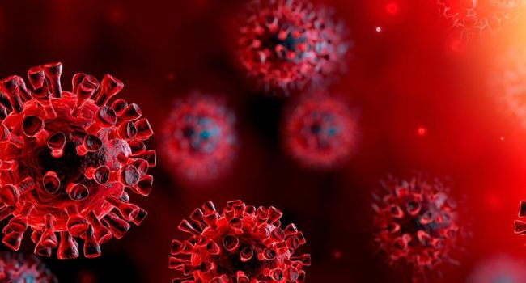
C
O
V
I
D
19
App
T
R
A
C
K
E
R

Slide 2
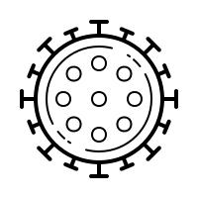
What we talk today?
What we talk today?
Kaung Htet Nyein . ….. (Use Case Diagram)
Kyaw Myo Tun (Class Diagram)
Khin Nyein Wai (Flow Chart)
Question (whole group)

Slide 3
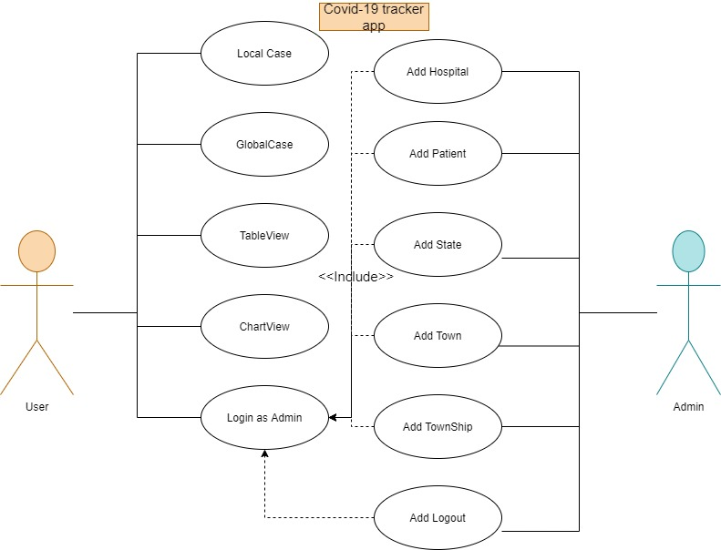
U s e C a s e
Use Case Diagram
I am User
D
I
A
G
R
A
M

Slide 4
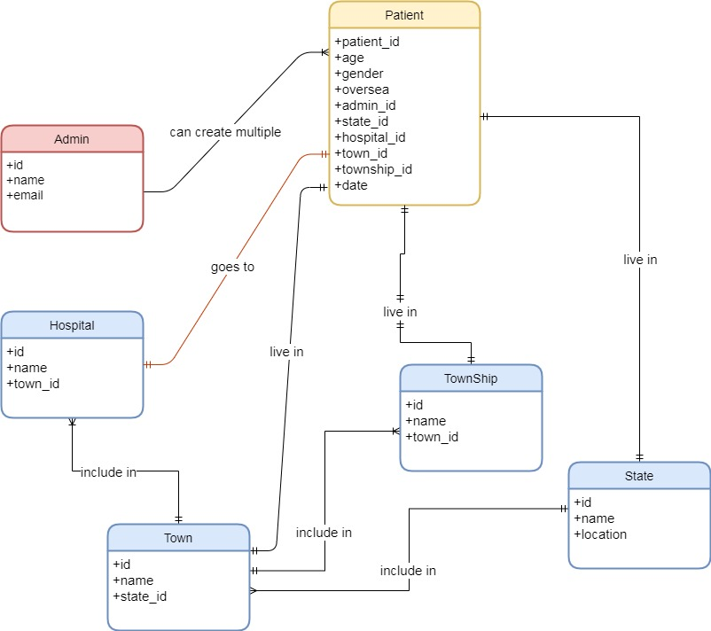
What we talk today?
E
R
D
I
A
G
R
A
M

Slide 5
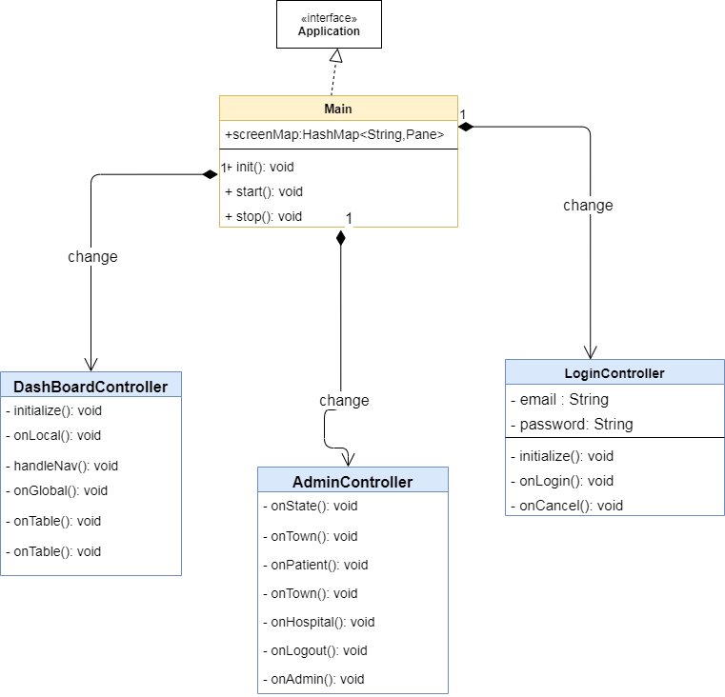
What we talk today?
Class Diagram
M
A
I
N
C
L
A
S
S

Slide 6
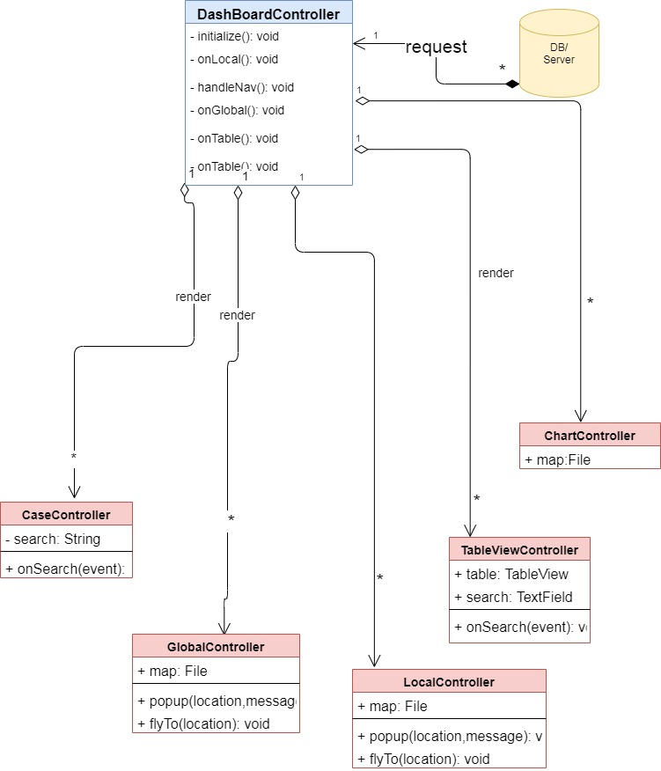
What we talk today?
D
A
S
H
B
O
A
R
D
C
O
N
T
R
O
L
L
E
R

Slide 7
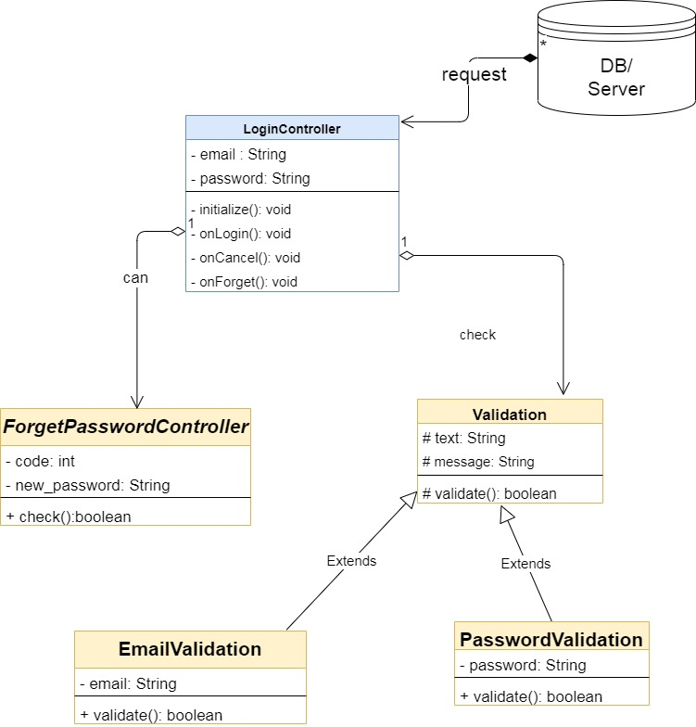
L
O
G
I
N
What we talk today?
C
O
N
T
R
O
L
L
E
R

Slide 8

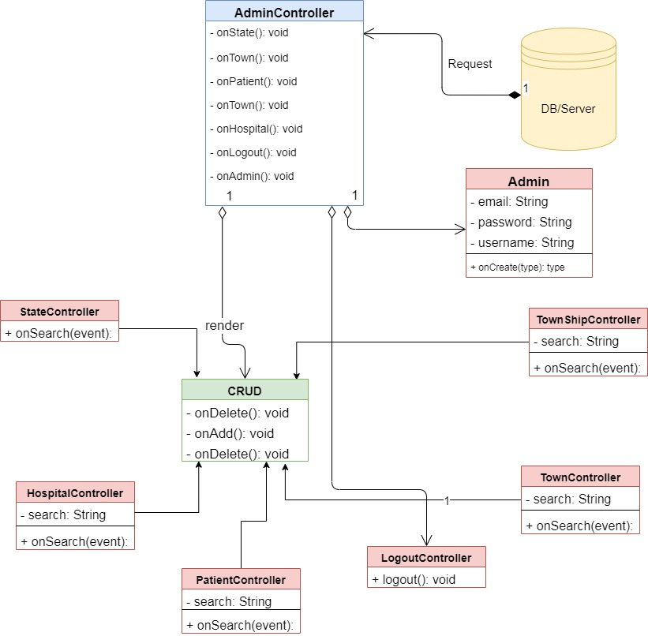
What we talk today?
A
D
M
I
N
C
O
N
T
R
O
L
L
E
R

Slide 9
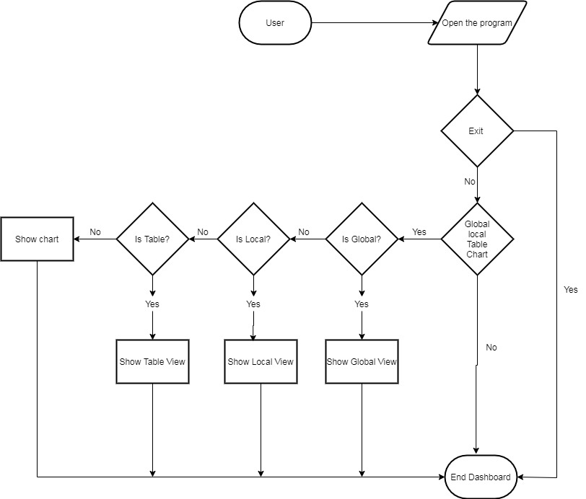
GWhat we talk today?
Flow Chart
U
S
E
R
V
I
E
W

Slide 10
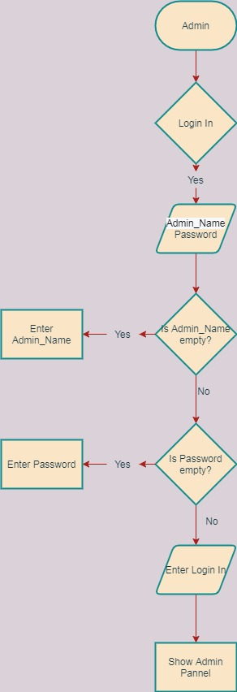
What we talk today?
A
D
M
I
N
P
A
N
N
E
L

Slide 11
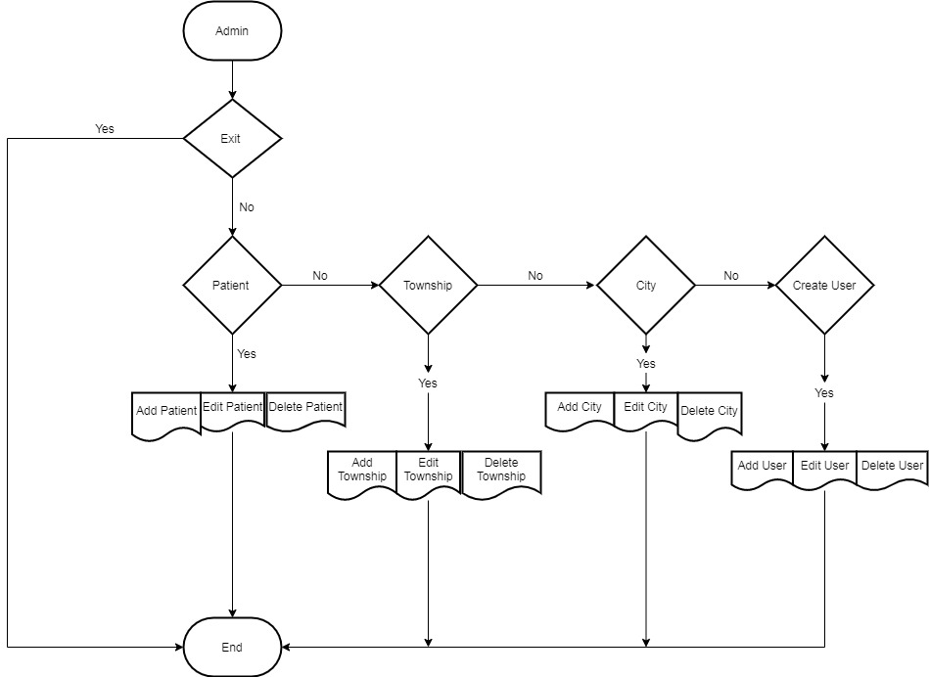
What we talk today?
A
D
M
I
N
M
A
N
A
G
E
M
E
N
T

